Slide 1

National University of Computer and Emerging Sciences,
Islamabad, Pakistan
Introduction to Course
Deep Learning
Dr. Noshina Tariq
Department of AI & DS

Slide 2
Instructor Information
Instructor |  | Dr. Noshina Tariq | E-mail | noshina.tariq@isb.nu.edu.pk
Current Position |  | Assistant Professor | Department | AI & DS
PhD : FAST, NUCES Research Interest : AI, Cyber Security, IoT, Cloud and Fog Computing, Blockchain, WSNs
Office | D block, 2nd Floor, Office # D-202 D, |  | Contact: 03335250303 |  | 111-128-128; Ext. ?

Slide 3
Meeting Hours (Tentative)
 Schedule and Office Hours (Fall-2025)
Days | 10:00 AM 11:20 AM | 11:30 AM 12:50 PM | 1:00 PM 2:20 PM | 2:20 PM 3:50 PM | 3:55 PM 4:50 PM |  |  | 5:20 PM 6:40 PM
Monday |  |  |  |  |  |  |  |  | DL (C-307)
Tuesday | Info Sec (BSDS-A) | Info Sec (BSDS-B)
Wednesday |  |  |  |  |  |  |  |  | DL (C-307)
Thursday | Info Sec (BSDS-A) | Info Sec (BSDS-B) |  | Office Hours
Friday | Office Hours | Office Hours

Slide 4

It’s Your Turn
To Introduce Yourself
Your Name
Educational Background
Generated using: GPT 4o

Slide 5
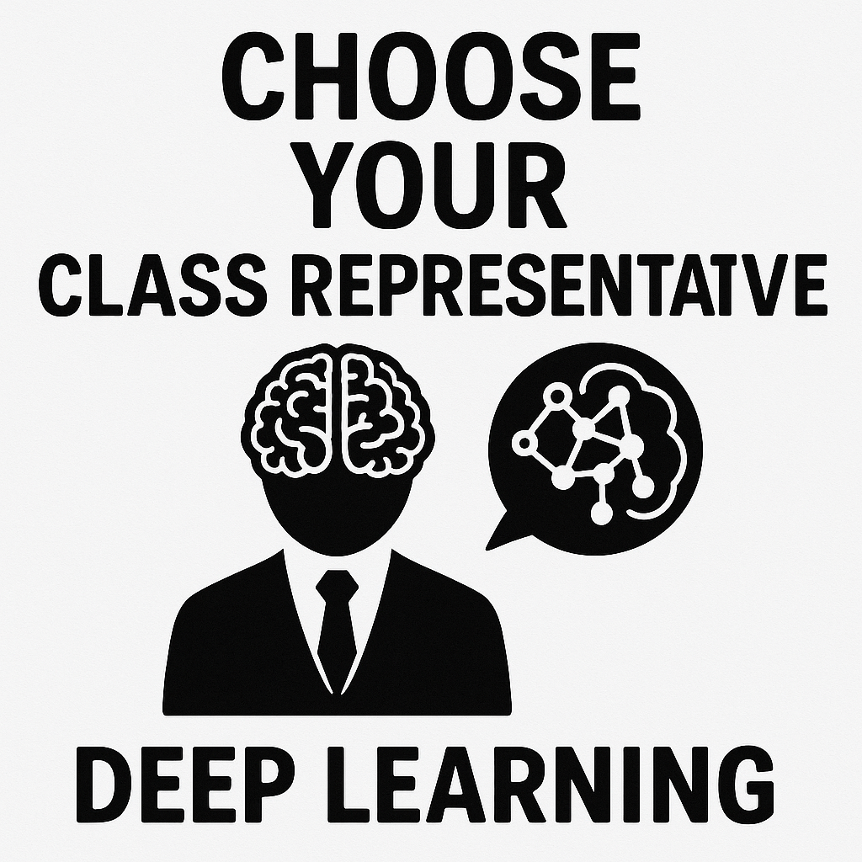

An activity
Make a WhatsApp group
Generated using: GPT 5

Slide 6
Course Information
Deep Learning
3+0
Understand the Fundamentals of Deep Learning
Implement Neural Network Architectures
Solve Real-World Problems with Deep Learning

Slide 7
Course Materials
Will be shared via Google Classroom
Class Code
sr2pyool

Slide 8
Prerequisite(s)
There is no official prerequisite for this course.
Concepts of Machine Learning
Good programming skills especially with one of the following tools:
Python / C++/Java
Machine Learning Frameworks
Scikit-Learn
Tensorflow / Keras , PyTorch, DEEPLEARNING4J, Microsoft Cognitive Toolkit, Caffe

Slide 9

Text Book
No official Text Book to follow

Slide 10
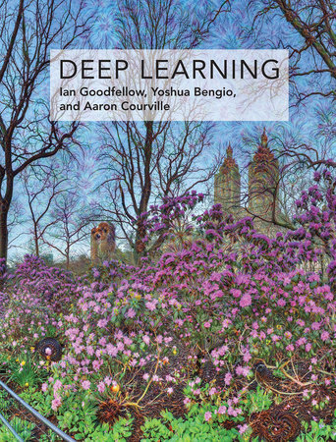
Reference Books
Deep Learning, by Ian Goodfellow and Yoshua Bengio and Aaron Courville, MIT Press.
Available Online

Slide 11
Reference Book(s)
Research Papers
Neural Networks and Deep Learning : A Textbook, Charu C. Aggarwal
Deep Learning with Python, François Cholle
Machine Learning and Deep Learning with Python, scikit-learn and TensorFlow, Sebastian Raschka and Vahid Mirjalili

Slide 12

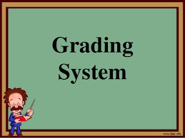
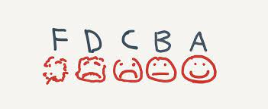
Grading Policy
Absolute Grading

Slide 13
Grading Policy
Assessment Item | Number | Weight (%)
Assignments | 3-4 | 15
Quizzes | 4 | 10
Research Project | 1 | 10
Sessional-I | 1 | 12.5
Sessional-II | 1 | 12.5
Final Exam | 1 | 40

Slide 14
Explanation of Assessment
All assignments and Quizzes carry equal weightage
Enough Time will be given for Assignments for their implementation.
Quizzes can be announced or unannounced.
All codes must be hosted on private GitHub repositories, with the instructor and all TAs as collaborators, using GIT extensively for version control.
Project will be can be done in Groups (max 2) or individually.
Project include writing a research paper for publication.
You will be using Overleaf for Writing the paper and presenting the results.

Slide 15
Submission for Assignment / Project
Every assignment and project deliverable will have a 2-hour grace period.
During which no penalty will apply.
This is intended to allow you time to verify that your submission has been submitted properly.
We recommend you re-download it and look it over to make sure all deliverables have been answered.
Deliverables after the grace period will receive a grade of 0.

Slide 16
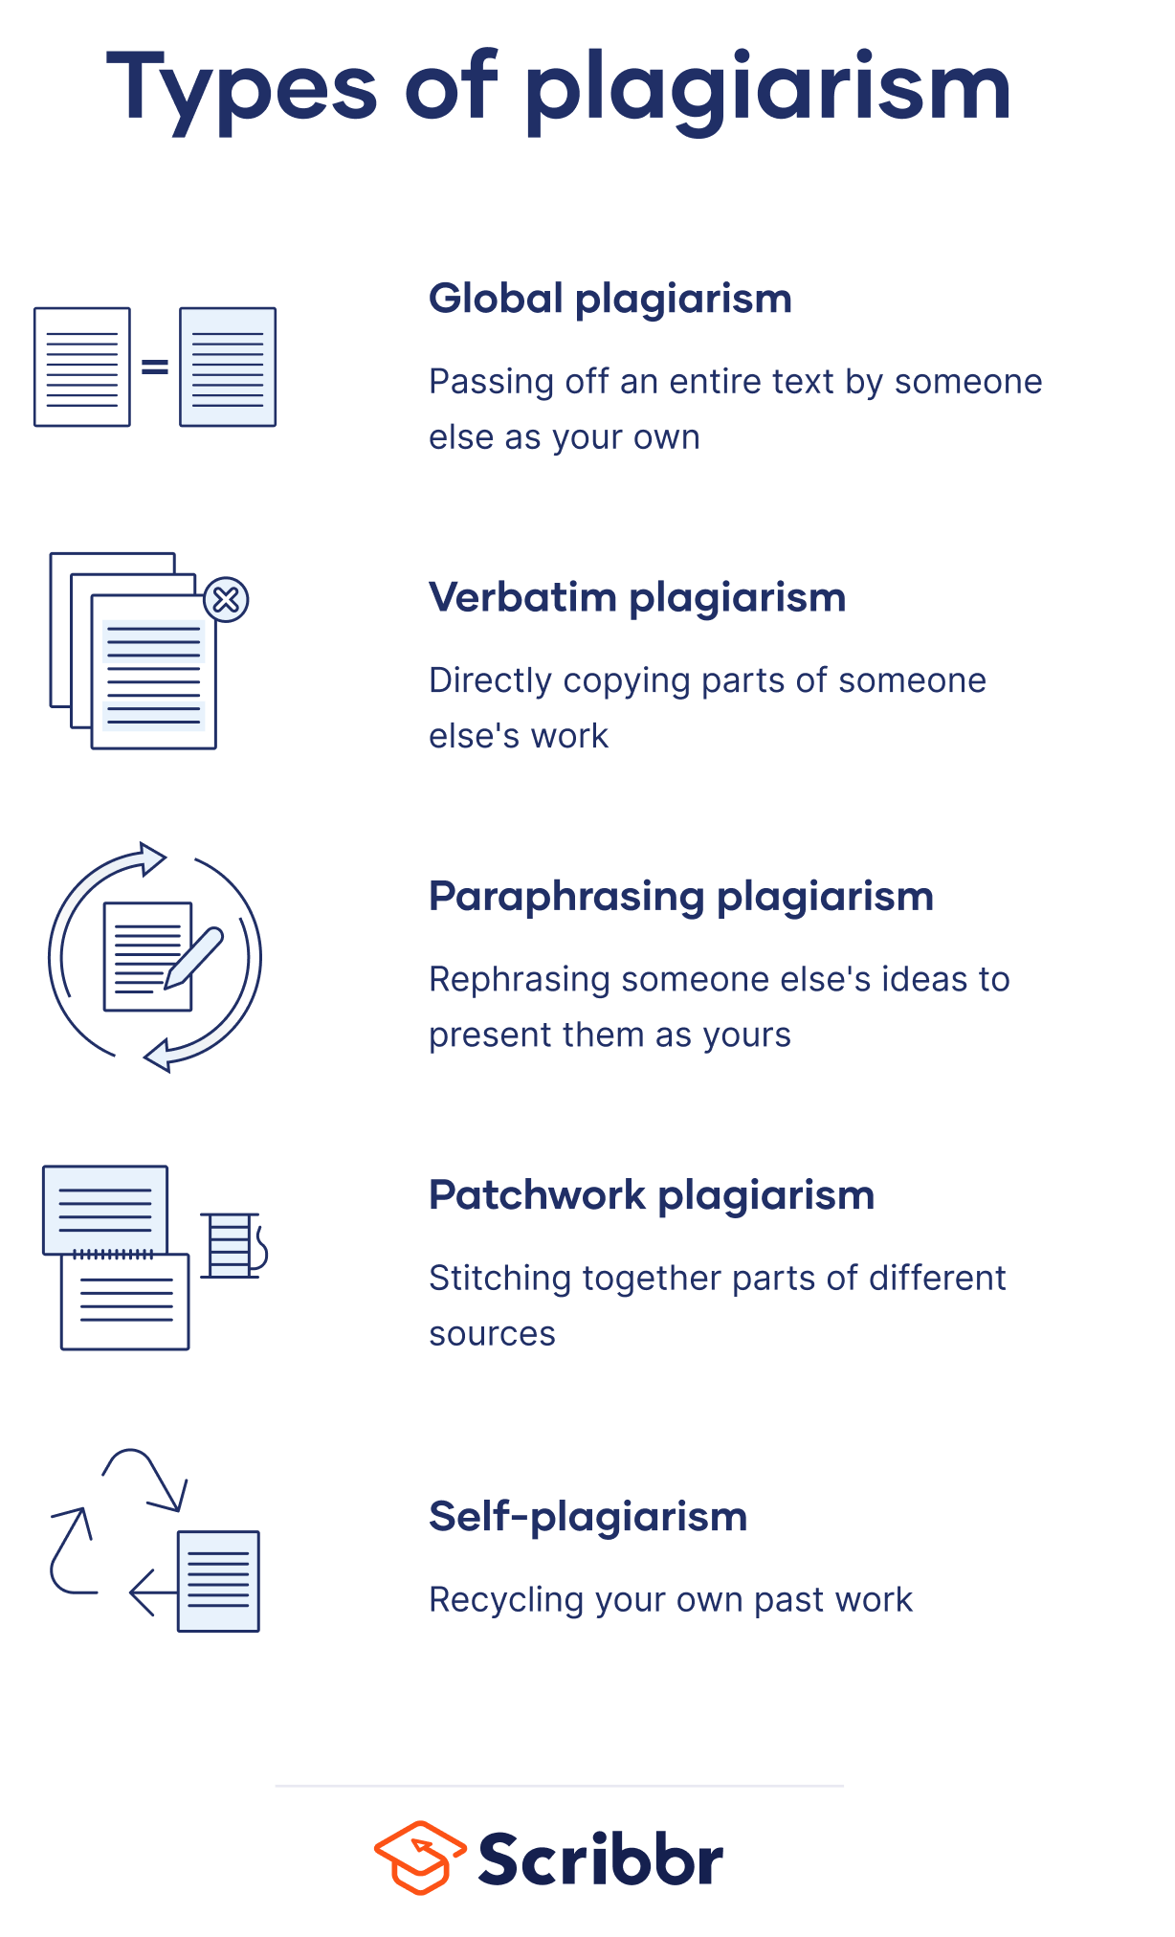
Course Plagiarism Policy
Plagiarism in any kind of assessment including project or sessional/ final exam, assignments quizzes, will result in F grade in the course.
So what is it?
Plagiarism is presenting someone else's work or ideas as your own, with or without their consent, by incorporating it into your work without full acknowledgement. All published and unpublished material, whether in manuscript, printed or electronic form, is covered under this definition.

Slide 17
Missed Assessment
Retake of missed assessment items (other than sessional/ final exam) is NOT allowed.
Missed assessment item (other than sessional / final exam) will earn zero marks
Late submission will NOT be accepted (Even by one second).
For missed sessional/ final exam due procedure will be followed.
No change is any deadline

Slide 18

Course Plagiarism Policy
Project Paper
Plagiarism for paper will be checked via Turnitin software
Any paper with score greater than 15% will be considered plagiarized and ZERO marks will be awarded.
Content will be also checked for AI Generated plagiarism, it must not exceed 20% too.

Slide 19
Attendance policy
Students are supposed to have 100% attendance.
The minimum attendance requirement at all levels and in all courses is 80%.
The relaxation of 20% attendance has been given only to cover any planned events or unforeseen situations.
I will take attendance at the start of lecture, within 15 minutes.
Ideal: 0 - 10 minutes Present 10-15 mins marked as Late, beyond 15 you ll be marked ABSENT.
Beyond 15 minutes, you will be marked ABSENT.

Slide 20

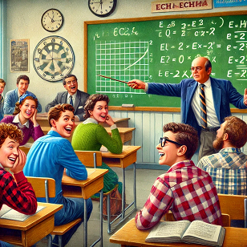
Student Responsibility
Mobile Usage
Use of mobile phones should be avoided.
You can leave the class in case of an emergency
Discussion
Class participation is highly appreciated
You can ask questions in the class(Highly Appreciated)
Discussion among students is not allowed until asked.
Generated using: GPT 4o

Slide 21
Motivational Stuff
Be humble
Always try your best. Never give up!
Be open to new ideas and change with an open mind!
Respect everyone in the class.
Welcome to discuss anything if you face any issues.

Slide 22
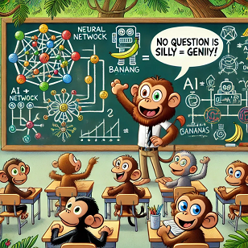
Classroom Engagement
Interactive Learning Experience!
Your Questions Are Always Welcome!
No question is too small, silly, or "wrong"—this is a safe space for curiosity.
If you’re wondering about something, chances are others are too! Ask away—you’ll be helping the whole class.
Active Participation is Key
Generated using: GPT 4o

Slide 23
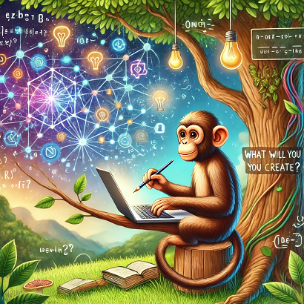
Course philosophy and resources
Please use the available resources
Collaboration is encouraged
Me (email me, or just walk into my office during office hours)
Your classmates and friends
If under stress/unable to perform, please reach out
We will do our best to help you
Generated using: GPT 4o
No student left behind : In our ideal world everyone of you would earn
“GOOD GRADES”

Slide 24
Goals of this Course
This course is designed for graduate students to gain theoretical and practical knowledge of Deep Learning.
Course will cover some of the advanced level algorithms.
Covers algorithms, theory and practical applications

Slide 25
Reading Papers
Get use to reading research papers related to their topic and write a short report.
Particularly following items are required for discussion
Methodology of the paper
Main Contributions
Research Gaps
Experimental Results
Strong points and weak points

Slide 26
Course Objectives: By the end of the course, you will be able to…
Understanding some of the theory behind neural networks
The what, the why and the how
The math
And the occasional history
Will help you contextualize 2 and 3 below
Will help you develop and extend your ideas in the topic
Research / Grad school
And job interviews!
Build your own neural net components and tools
Work on large-scale problems

Slide 27
Course Objectives: By the end of the course you will be able to…
Understanding some of the theory behind neural networks
Build your own neural net components and tools
Work on large-scale problems

Slide 28

Lecture Style
My lecture style is verbose
many slides
Code Demonstrations
Practical coding examples
Reading Research Paper
Generated using: GPT 4o

Slide 29
Outline
Week | List of Topics | Hours | CLO(s) | Assessments
1 | - Introduction to the Course - Machine Learning Overview | 3 | 1
2 | - Models for Linear Regression - Models for Linear Classification
3 | - Introduction to Artificial Neural Network: - Multilayer Perceptrons - Activation functions: Sigmoid, Tanh, ReLU, dropout | 3 | 1,2 | Assignment #1
4 | - Training Machine Learning Models with Backpropagation - Gradient Descent and Perceptron/Delta Learning | 3 | 3 | Select Project Topic
5 | Introduction to Deep Convolutional Neural Networks Well known Architectures: - LeNet, AlexNet, VGGNet | 3 | 3
6 | Sessional -I

Slide 30
Outline
Week | List of Topics | Hours | CLO(s) | Comments
7 | - Deep Learning for Object Detection and Image Segmentation - YOLO (You Only Look Once) | 3 | 1,2,3
8 | - Deep Learning for Object Detection and Image Segmentation: R-CNN Family Single Shot MultiBox Detector (SSD) | 3 | 2,3,4,5 | Assignment #2
9 | Introduction to Semantic segmentation - Well known architectures: U-Net, ResNet, DenseNet, EfficientNet
10 | - Introduction to Recurrent neural networks: -Long Short-Term Memory (LSTM) - Gated recurrent unit (GRU) | 3 | 1,2,4,5 | Assignment #3
11 | - Introduction to Transformers - Vision Transformers (ViT) | 3 | 1-5
12 | Sessional -II

Slide 31
Outline
Week | List of Topics | Hours | CLO(s) | Comments
13 | Introduction to Graph Neural Networks - Machine Learning on Graphs - Graph Convolution Filters | 3 | 4,5
14 | Deep Reinforcement Learning - Q-learning - Policy gradients | 3 | 4,5
15 | Explainability in Deep Learning - Importance of model interpretability - Techniques: SHAP, LIME, Grad-CAM | 3 |  | Project Submission
16 | Project Presentations | 3
 | Final Exam

Slide 32
Lecture #1

Slide 33
Goals
This lecture will cover:
Why Machine Learning?
Development Environment Setup/ Mendeley/Overleaf
Research Stages

Slide 34
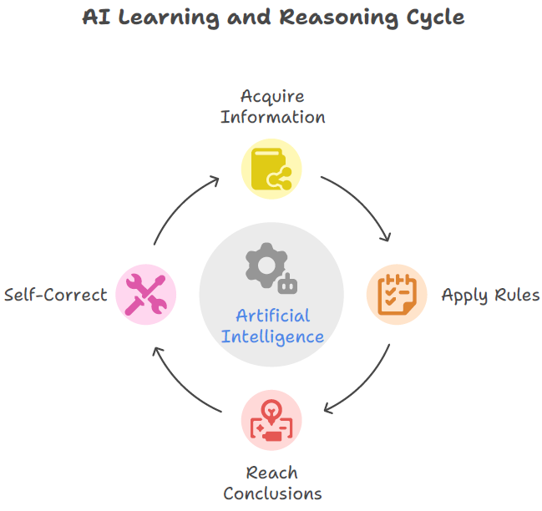
Artificial Intelligence (AI) refers to the simulation of human intelligence processes by computer systems. These processes include learning (the acquisition of information and rules for using the information), reasoning (using rules to reach approximate or definite conclusions), and self-correction. More specifically, AI is a broad field encompassing various techniques and approaches that enable machines to perform tasks that typically require human intelligence.

Slide 35
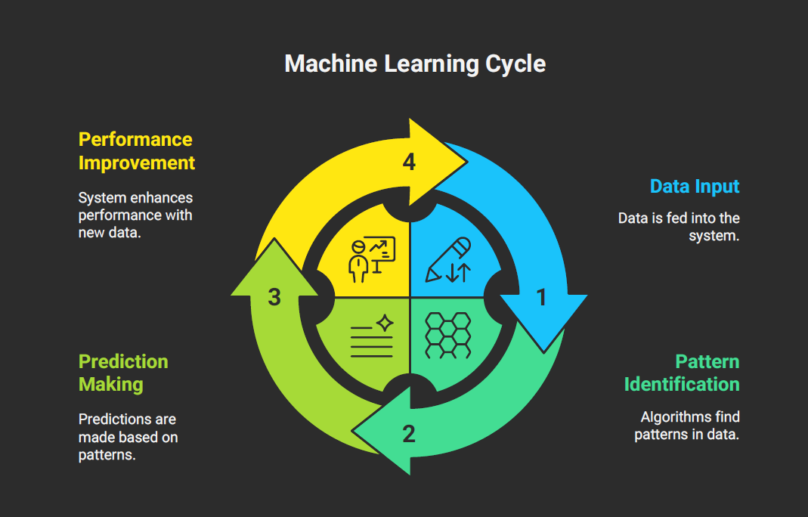
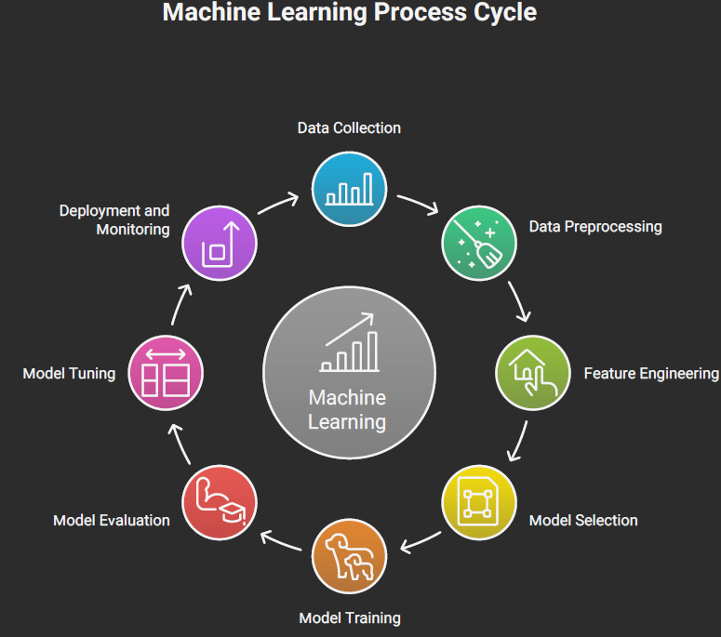
Machine learning (ML) is a subfield of artificial intelligence (AI) that focuses on enabling computer systems to learn from data without being explicitly programmed. Instead of relying on predefined rules, ML algorithms identify patterns, make predictions, and improve their performance over time as they are exposed to more data. In essence, machine learning empowers computers to learn and act like humans, and improve their learning over time in an autonomous fashion, by feeding them data and information in the form of observations and real-world interaction.

Slide 36
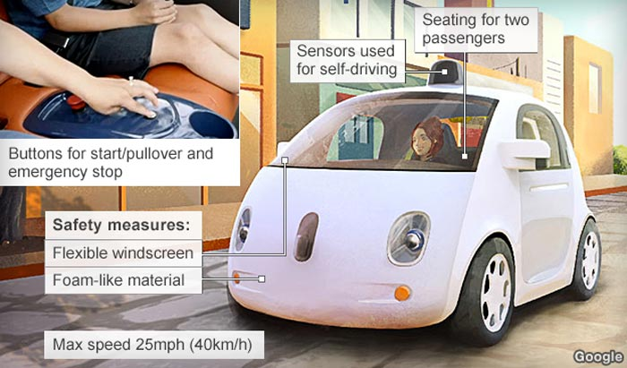
Machine Learning in Action

Slide 37
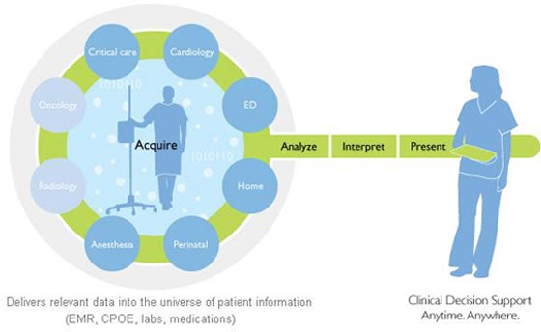
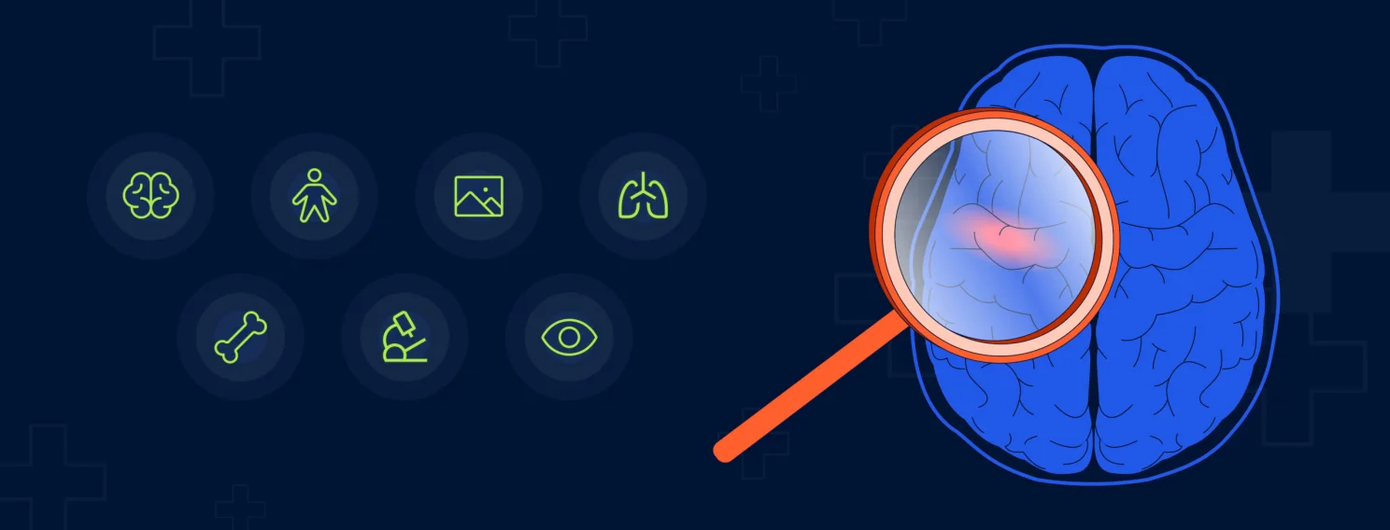

Machine Learning in Action
Computers learning from medical records which treatments are most effective for new diseases
http://www.healthcare.philips.com/main/products/hi_pm/products/clinical_support.wpd

Slide 38

Machine Learning in Action
Houses learning from experience to optimize energy costs based on the particular usage patterns of their occupants

Slide 39
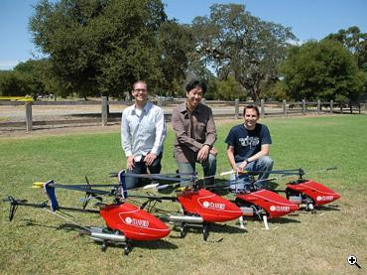
Machine Learning in Action
Helicopters can learn aerial tricks by watching other helicopters perform the stunts first

Slide 40
Machine Learning in Action
Document Classification

Slide 41

Machine Learning in Action
Stock Market Prediction

Slide 42
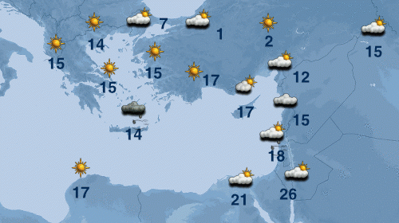
Machine Learning in Action
Weather Prediction

Slide 43


AI in E-Commerce

Slide 44
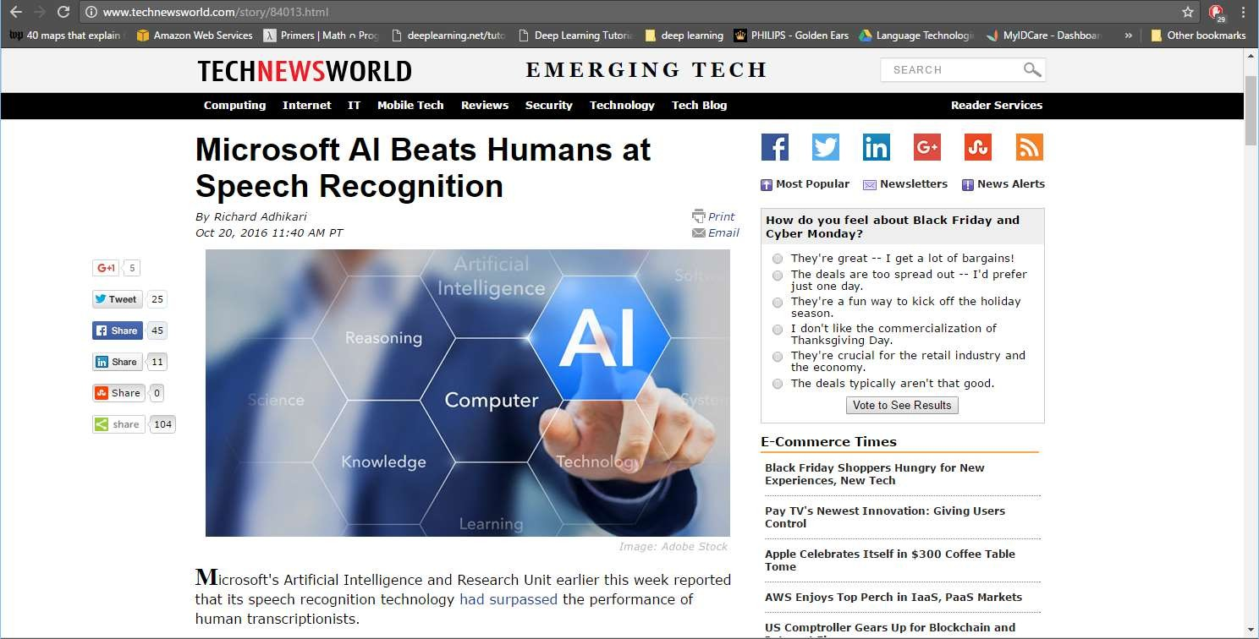
Breakthroughs with neural networks
20

Slide 45
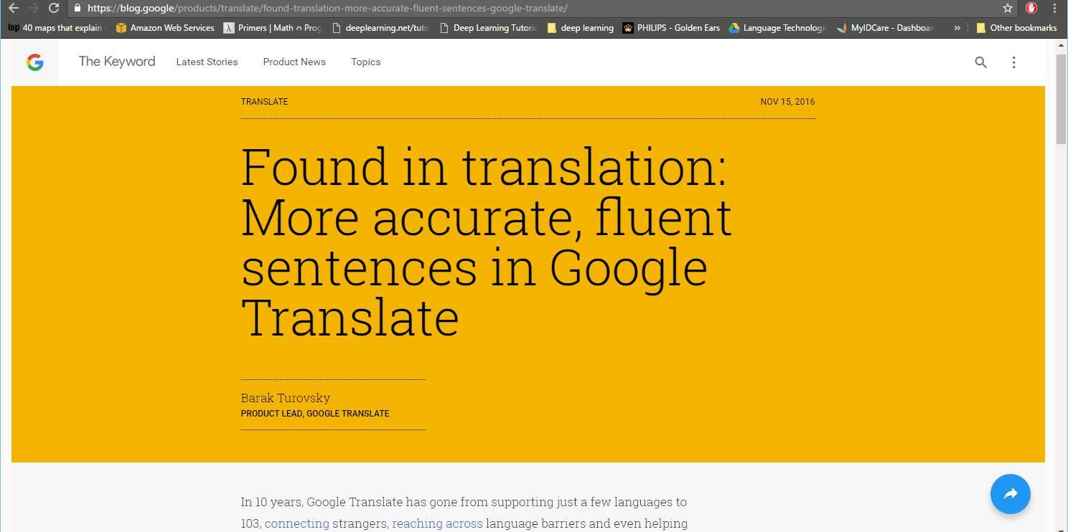
Breakthrough with neural networks (2016)

Slide 46
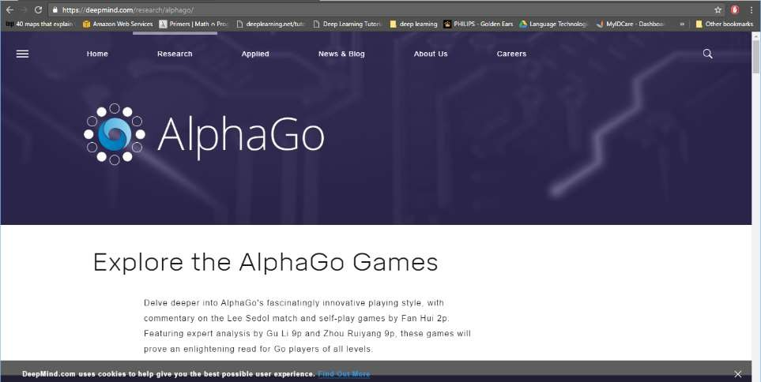
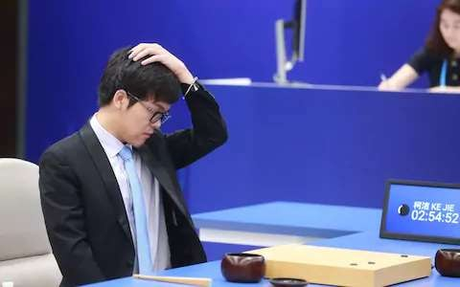
Breakthroughs with neural networks

Slide 47
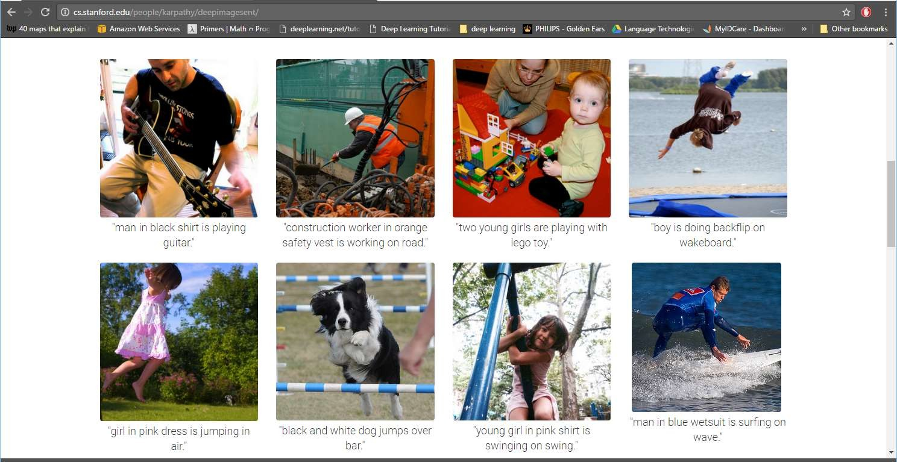
Success with neural networks
Captions generated entirely by a neural network
23

Slide 48
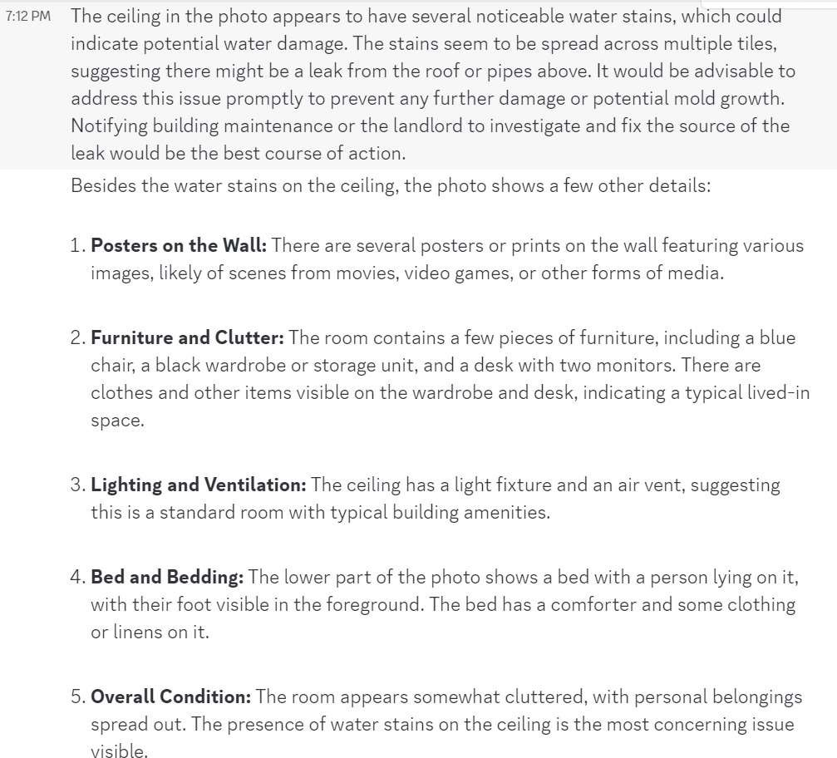

And now…
ChatGPT, tell me about this picture

Slide 49
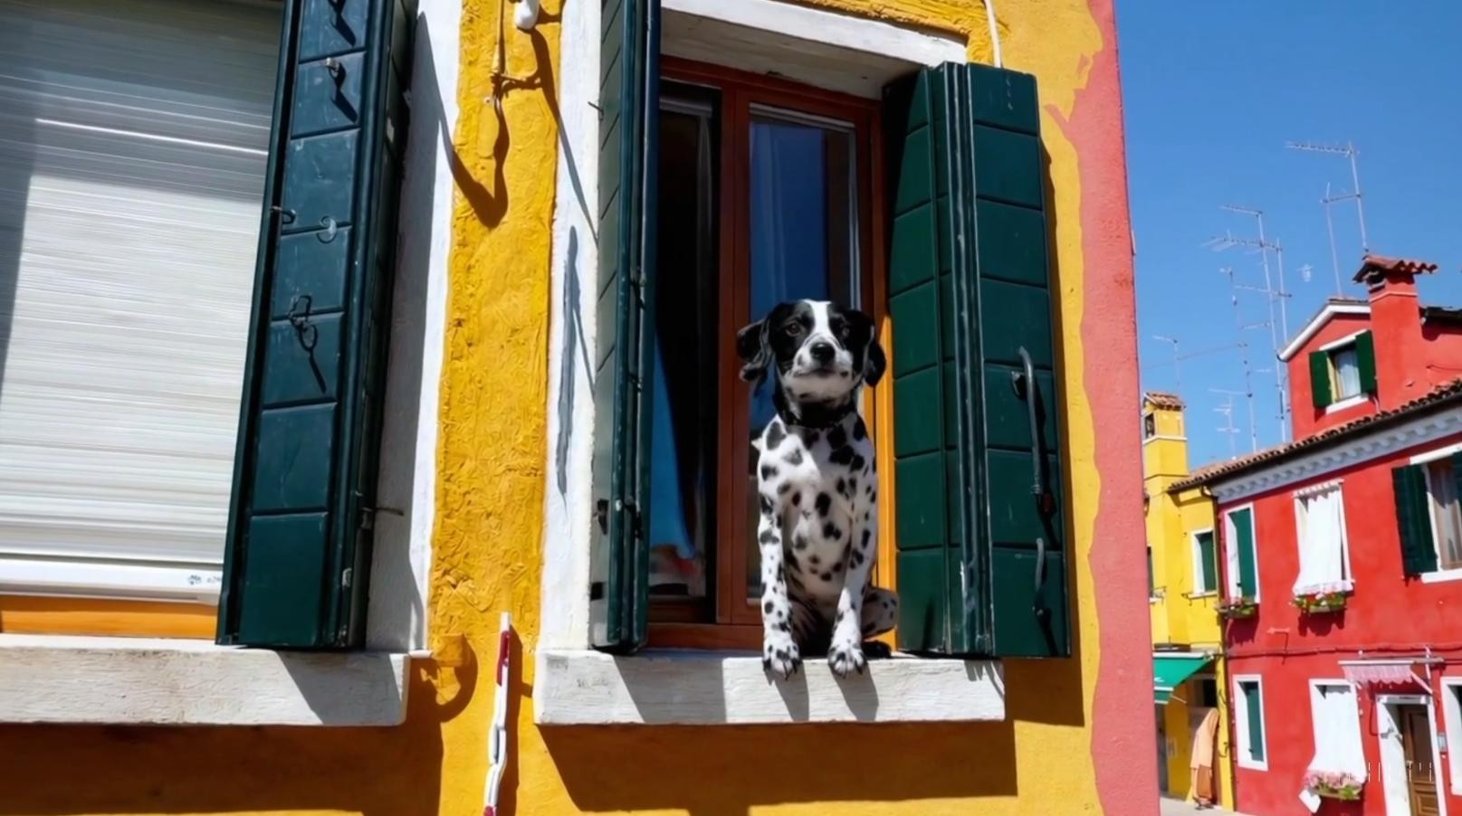
OpenAI SORA, 2024

Slide 50
Why ML?
Data is everywhere and is generated at high speed.
Example: Every second, on average, around 6,000 tweets are tweeted 350,000 tweets sent per minute, 500 million tweets per day and around 200 billion tweets per year.
Writing a computer program with if-else conditions to solve a problem including lot of data is practically not feasible
Machine Learning algorithms can provide a better solution
Understand the data and make prediction on unseen data

Slide 51
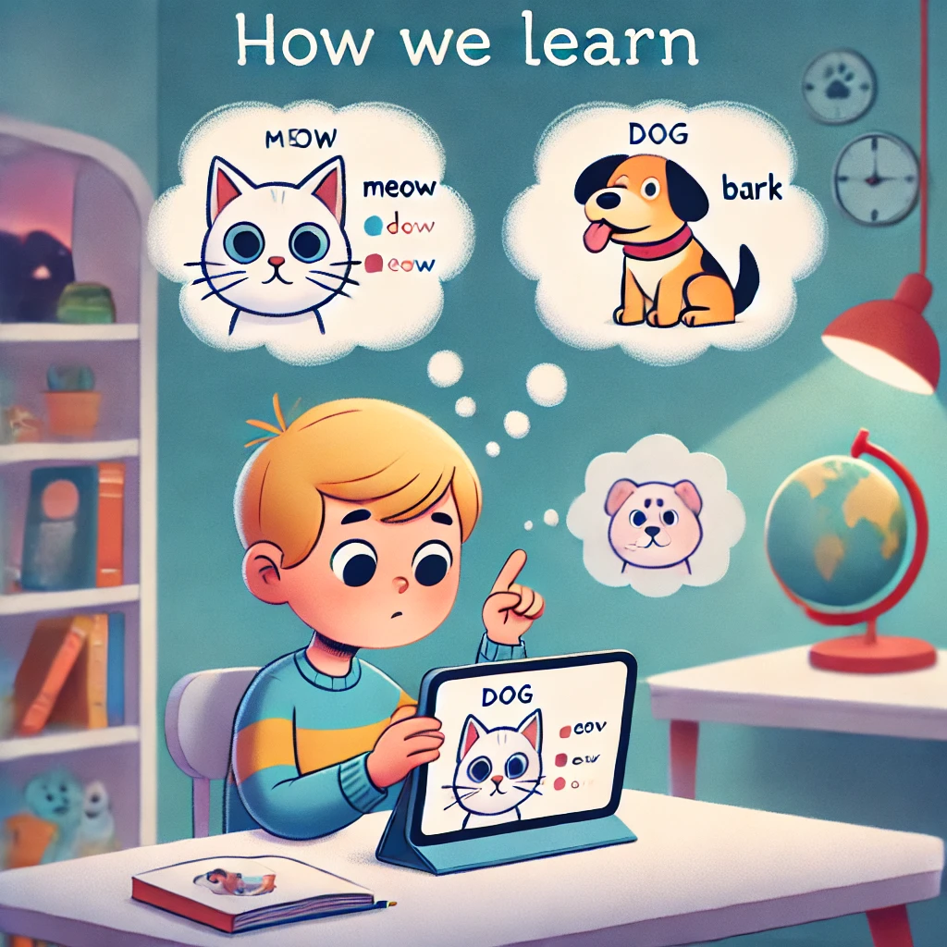
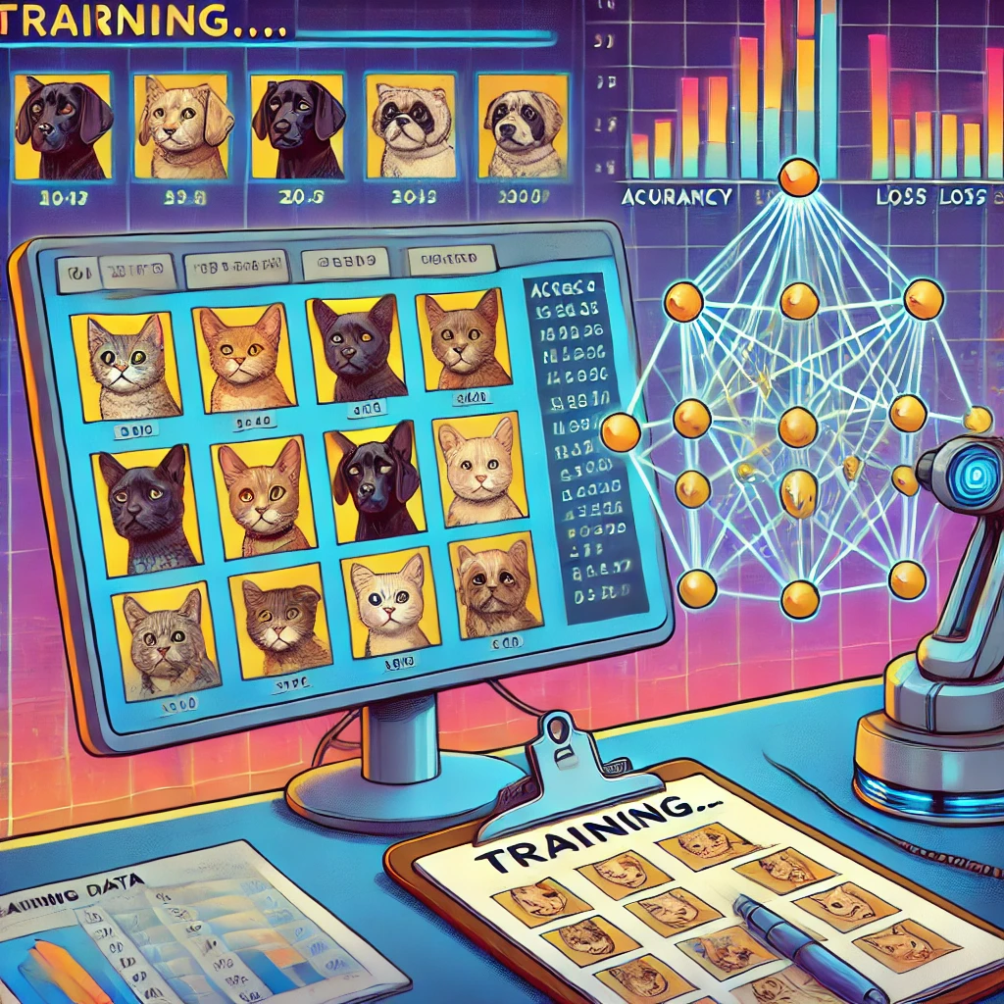
Human Analogy

Slide 52
Why ML?
Traffic Alerts (Maps)
Spam Detection
Social Media
Products Recommendations
Speech Recognition
Speech to Text Conversion
Text to Speech Conversion

Slide 53
Why ML?
Fraud Detection
Sentiment Analysis
Chatbots
ML for health care
Detection and diagnosis
Discovery of new drugs
Security Purposes
Cyber threat detection
Weapon Detection

Slide 54
Why ML?
Faults Detection
Character recognition
Automatic License Plate Recognition
Fingerprint Recognition
Face Recognition
Autonomous Car driving
Object Detection and Tracking

Slide 55
AI Applications
Gaming
AI-driven Opponents: Deep learning has revolutionized gaming, with AIs like AlphaGo defeating world champions in games like Go and chess.
Computer Vision
Image Recognition: Deep learning powers systems like facial recognition (e.g., Face ID) and object detection (e.g., autonomous vehicles identifying road elements).
Medical Imaging: AI models like Google DeepMind assist in detecting diseases like diabetic retinopathy, cancer, and heart conditions with remarkable accuracy.
Self-driving Cars: Companies like Tesla and Waymo rely on deep learning for real-time object detection, navigation, and decision-making.
Satellite Image Analysis: Used for climate change monitoring, deforestation analysis, and disaster response.

Slide 56
AI Applications
Natural Language Processing (NLP)
Machine Translation: Tools like Google Translate use deep learning to translate languages with near-human accuracy.
Chatbots and Virtual Assistants: Siri, Alexa, and Google Assistant use deep learning for voice recognition and natural language understanding.
Sentiment Analysis: Businesses analyze customer feedback and social media sentiments using deep learning.

Slide 57
AI Applications
Healthcare
Drug Discovery: Deep learning models like AlphaFold2 predict protein folding, accelerating drug discovery and development.
Personalized Medicine: AI tailors treatments based on patient data, improving healthcare outcomes.
Robotic Surgery: AI assists in precision surgeries using deep learning for enhanced vision and control.

Slide 58
AI Applications
Entertainment and Media
Content Recommendation: Netflix, Spotify, and YouTube use deep learning to personalize recommendations for users.
Deepfake Technology: While controversial, deepfake technology leverages deep learning for realistic video and audio synthesis.
CGI and Visual Effects: AI enhances CGI creation in movies and games with realism and automation.

Slide 59
AI Applications
Autonomous Systems
Drones: Deep learning enables autonomous drones for deliveries, surveillance, and search-and-rescue missions.
Robotics: Robots powered by AI, such as Boston Dynamics' robots, exhibit remarkable capabilities like balancing and navigating complex terrains.

Slide 60
AI Applications
Finance
Fraud Detection: Banks and fintech companies use deep learning to detect fraudulent transactions and patterns.
Algorithmic Trading: AI models predict market trends and automate trading decisions with high efficiency.
Credit Scoring: Deep learning analyzes vast datasets to assess creditworthiness.

Slide 61
Development Environment Setup
Download and Install Anaconda
https://www.anaconda.com/
Individual Edition is Free
Conda Installation of Tensorflow:
https://docs.anaconda.com/free/anaconda/applications/tensorflow/
PIP Installation
https://www.tensorflow.org/install/pip#linux

Slide 62
Paper Writing
A typical paper must consists of following main section
Abstract
Should be one paragraph explaining what is being presented in the paper
Introduction
A short explanation of the problem and reviews of the existing research.
You must download and review at least 10-15 papers (Journal Papers are highly encouraged)
Data Set
Which data has been used for this study
Methodology
What method(s) has been implemented
Experimental Results
Explanation of the results obtained. Should include figures, tables etc.
Conclusion
Summarize what you did overall
References
Bibliography of which papers were reviewed or used in the paper

Slide 63
Overleaf
The easy to use, online, collaborative LaTeX editor.
Overleaf is used by over nine million students and academics at 6,800 institutions worldwide
Work from anywhere
https://www.overleaf.com

Slide 64
Getting Started with Research
Step 1. Select a Topic
Your interests and Skills
Supervisor / Project
Availability of resources
Step 2. Search for Relevant Information
IEEE Explore
Springer
Scopus
Web of Science
Google Scholar

Slide 65
Getting Started with Research..
Step 3. Organize Resources
Zotero
EndNote
Mendeley
JabRef
License
MarginNote
Step 4. Write Paper
Outline the Paper
Take Notes
Avoid Plagiarism

Slide 66
References
Deep Learning, Ian Goodfellow, Yoshua Bengio, Aaron Courville
Lectures of Prof. Dr.-Ing. Andreas Geiger, Autonomous Vision Group, University of Tubingen
Lecture notes of Bhiksha Raj, Rita Singh

Slide 67
Thank You ☺

